Slide 1

IMPLEMENT AND INVESTIGATE OF KNN CLASSIFIER
Presented By -
RISWAN BASHA SALEEM BASHA (1440928)
SHIVAKUMAR VEERAPUR (1445680)
DEBLINA KARMAKAR (1427365)
INDRANIL SAHA (1427190)
Examined by – Prof. Damir Dobric, Prof. Dr. Andreas Pech

Slide 2
Agenda
1. Problem Statement
2.Introduction
3.Working Principles of KNN
4.Design Principles of KNN Classifier
5.Building Blocks of the model
6.KNN model construction and Unit testing
7.Results
8. Conclusion

Slide 3
1. Problem Statement
Design the KNN Classifier that can work with the neocortex API and classify if the predicted sequence has a match or mismatch with the input sequence
Investigate the model with Unit Test

Slide 4
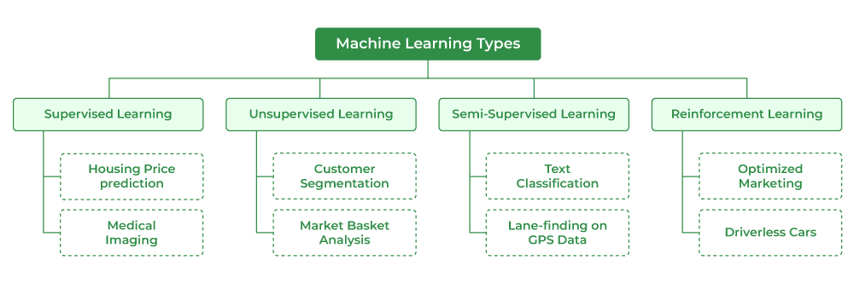
2. Introduction
Figure 2.1 : Machine learning types and its applications
Machine learning involves developing statistical models and algorithms that utilize the "learn" method to assist computers in predicting future outcomes using data. There are three primary categories of machine learning: supervised learning, unsupervised learning, and reinforcement learning. Supervised learning involves labeled data used to train the model, unsupervised learning works with unlabeled data to find patterns, and reinforcement learning centers on learning through interactions with an environment to achieve specific goals.

Slide 5
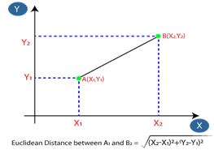
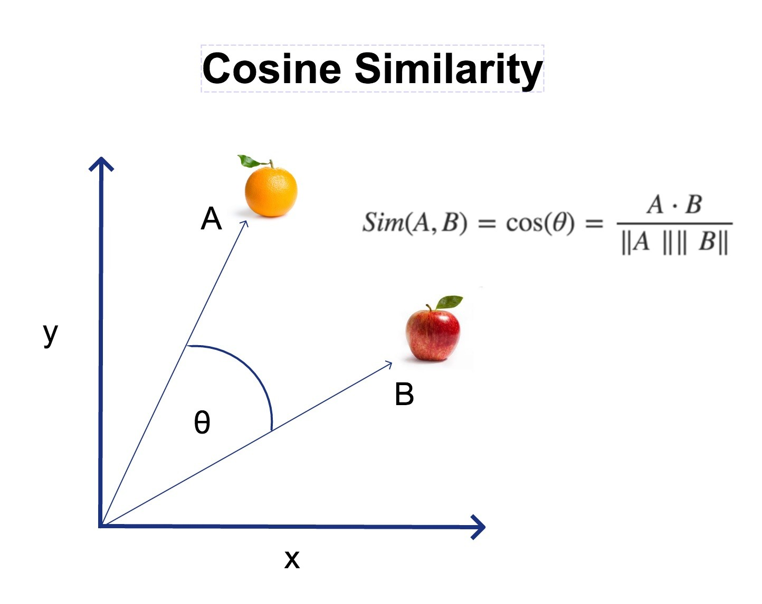
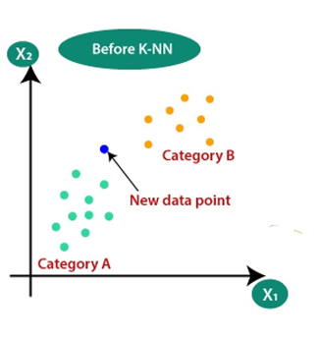
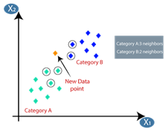
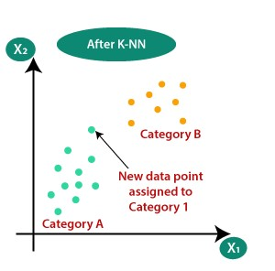
3. Working Principle of KNN
Step-1: Select the number K of the neighbors
Step-2: Distance calculation or Cosine Similarity & distance matrix table
Figure. 1: Plotting the input data and select the value of k
Figure. 2: Euclidian Distance Calculation and Cosine Similarity Calculation
Step-3: Weightage calculation for prediction of new point
Step 4: Predicting the category for new datapoint
Figure. 3: Weightage Calculations based on labels
Figure. 4: Predicting the Output labels

Slide 6

4. Design Parameters of KNN Algorithm
The K-Nearest Neighbors (KNN) classifier relies on several crucial parameters that significantly influence its performance:
K-value Selection: Choosing the number of neighbors, K, for distance calculations is pivotal. Opting for an odd value for K is often recommended to avoid ties in voting.
Distance Calculations: The method used to calculate distances between data points significantly impacts the model's accuracy. Commonly employed distance metrics include:
Weightage Mechanism: The algorithm employs a weightage mechanism to determine the prediction outcome derived from the calculated distances and the selected neighbors. This process entails assigning varying weights to neighboring points, culminating in predicting the class of the data point under consideration based on these weighted influences.
These design parameters, integrated with specific formulas, form the foundation of the KNN algorithm, enhancing its accuracy and efficiency in making predictions based on the provided dataset.

Slide 7
5. Building Blocks of the Model
Raw Input
Sequence of integer/float/character/pixel values
Encoder
Sequence of encoded integer/float/character/pixel values
Spatial Pooler
Converts the encoded input patterns into sparse distributed representations
Temporal Memory
KNN Classifier
Classifying/decoding if its matching or not matching with input sequence
Output
Match or Mismatch to the Raw input!!!

Slide 8
6. KNN Model Construction and Unit Testing
Learning
Prediction
Input
Check for other similar inputs
Include existing/add new
Input
Compare with Model
Get Similarities (Distance)
Calculate the similarities
Give the output
Figure. 6.1: KNN Learning Phase
Figure. 6.1: KNN Predicting Phase

Slide 9
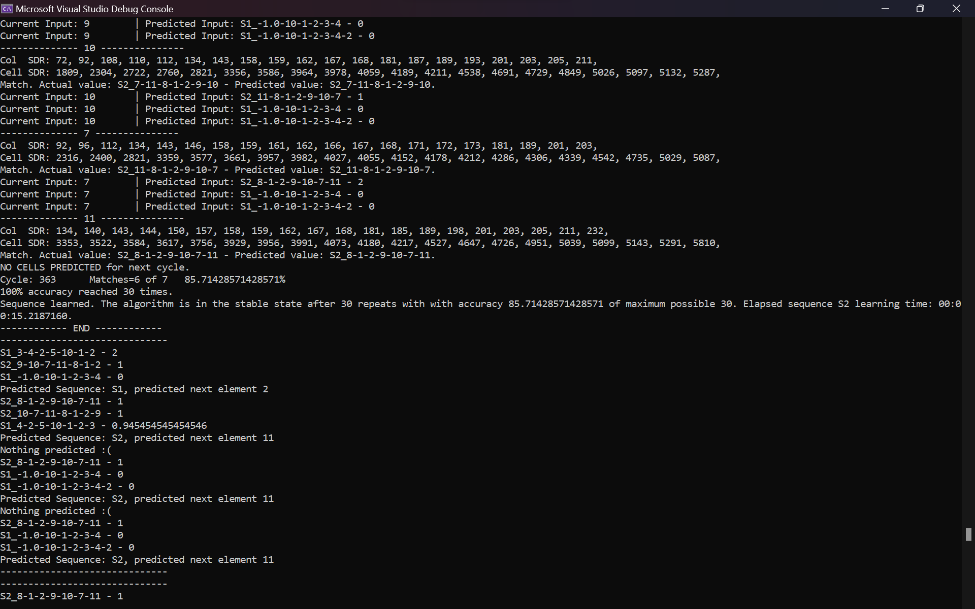
7. Results from Program.cs for Integer Inputs
Figure. 7.1: KNN Classification Output for normal Integer Sequence
The model takes in Input data from RunMultiSequenceLearningExperiment() and predicts the match if the output sequence has match with input sequence, or it will predict that it is not matching with input sequence.

Slide 10
7. Results from Program.cs for Image Pixel values
The method 'RunMultiSequenceLearningExperimentWithImage()' plays a pivotal role in our model's functionality by handling input images. Initially, this method initiates the process by receiving an input image. The image undergoes a crucial transformation within the 'ConvertImageToSequence()' function, where it gets converted into a sequence of pixels. This transformation is vital, as it ensures that every pixel within the image is uniquely represented within the sequence.
Subsequently, the model leverages this sequence of pixels to predict whether the input image corresponds to a match or a non-match. This prediction is based on whether the output pixel sequence aligns with the input pixel sequence. If a match is found between the output and input pixel sequences, the model predicts a match for the image. Conversely, if there's no correspondence between the sequences, the model predicts that the image does not match based on its pixel representation.
This classification process is fundamental, as it harnesses the uniqueness of each pixel within the image. By analyzing these individual pixels and their sequences, the model determines whether the given image matches the input pixel sequence. This approach serves as a powerful tool for discerning the similarity or dissimilarity of images based on their pixel compositions

Slide 11
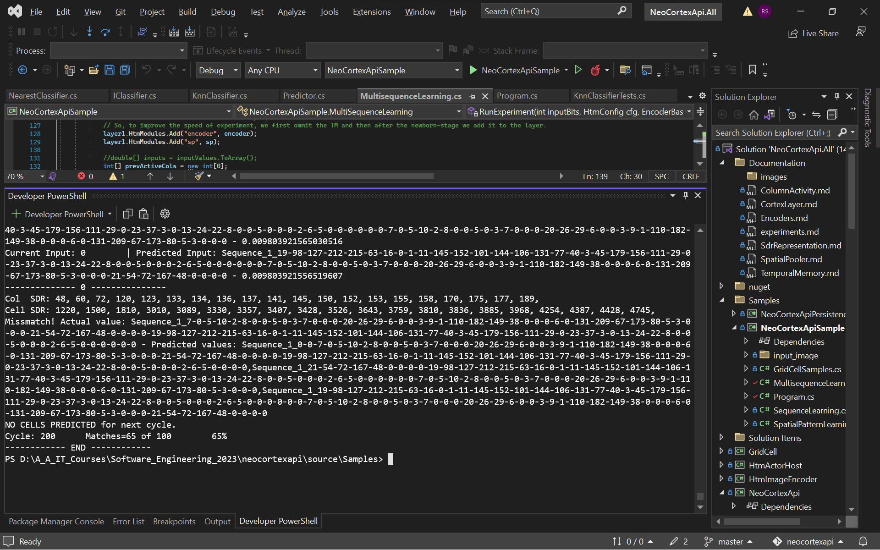
7. Results from Program.cs for Image Pixel values
In this context, the input image is sourced from the MNIST dataset, displaying the numeral '2'. Through a transformation, the image is converted into a sequence comprising 100 smaller sequences of pixels, encapsulating the core attributes of the handwritten '2'. While this sequence-based representation enables the model to discern similar pixel patterns indicative of the numeral '2', it's important to note potential limitations. Variations in writing styles, stroke thickness, or positioning within the image may result in diverse pixel sequences, potentially leading to misinterpretation. Consequently, even if representing the same digit, distinct pixel variations across different instances of '2' might not be correctly recognized as similar by the model, impacting its classification accuracy.
Figure. 7.2: KNN Classification Output for Image Pixel Sequence
Figure. 7.3: Input Image
Note: We have resized the pixel value to make our program run faster

Slide 12
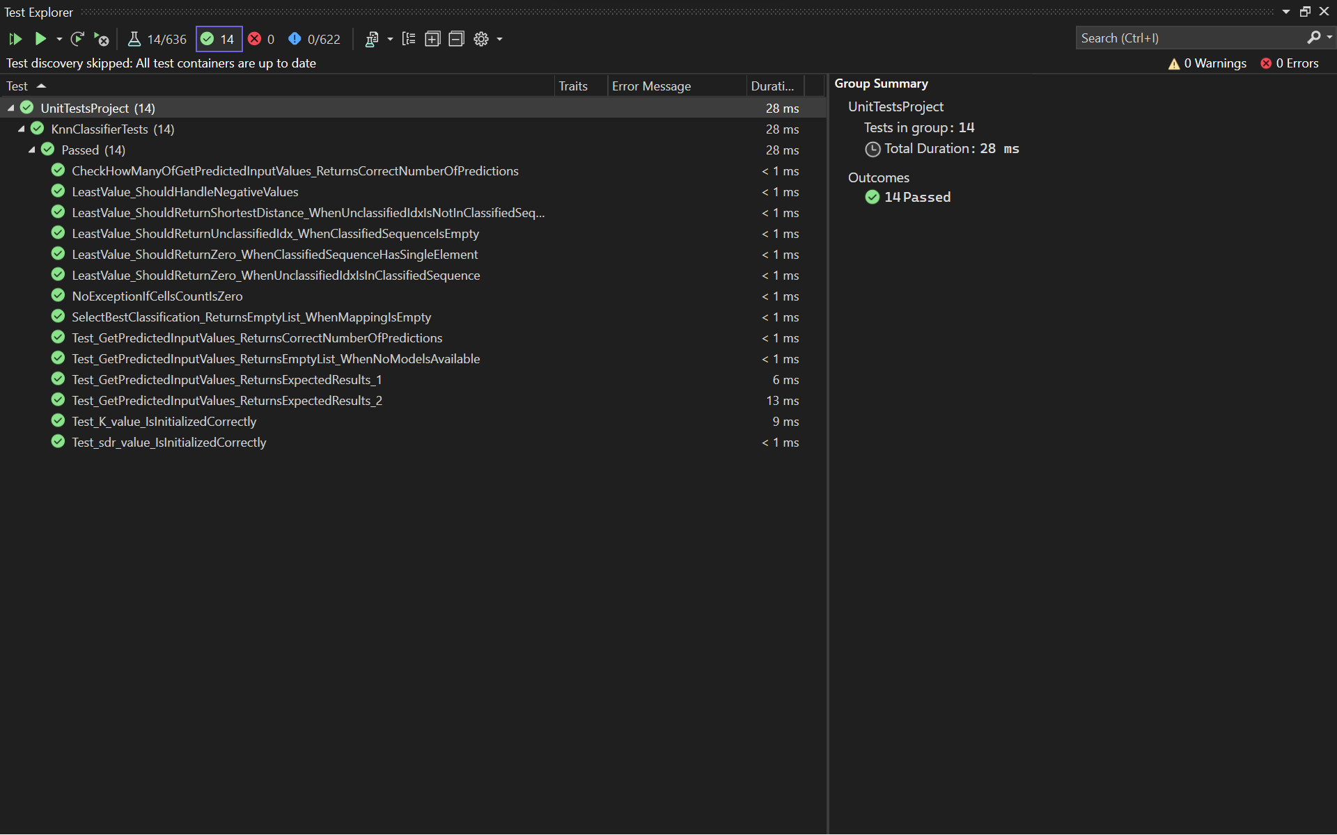
7. Results from Unit Test
Figure. 7.4: Unit Testing Of The KNN Algorithm
Unit tests have been integrated to address specific scenarios. All the unit tests created for the HTM Classifier have been applied to this classifier as well. During the model's testing phase, no instances of test failures have been identified.

Slide 13
8. Conclusion
Our development journey commenced with the creation of a versatile KNN prototype that delivered the expected outcomes. Building upon this foundation, we further refined and optimized the KNN model by seamlessly integrating it with the Neocortex API. Successfully integrated, our model exhibits adeptness in processing data streams to forecast outcomes effectively. Harnessing the combined capabilities of both cosine similarity and SoftMax functions within the KNN classifier, it proficiently categorizes output sequences. This capability allows the model to differentiate matches or mismatches against input sequences.
Notably, our model consistently achieves a remarkable 85.71% accuracy rate across a diverse range of normal integer input data sequences, showcasing its robustness. Moreover, in the domain of image classification, the model demonstrates a commendable 65% accuracy in processing pixel sequences. Additionally, comprehensive unit tests, including specialized cases, were implemented, yielding consistently satisfactory outcomes comparable to those achieved with the HTM Classifier. This holistic approach, leveraging cosine similarity and SoftMax functions, underlines the reliability and resilience of our model in predictive tasks, encompassing both standard integer sequences and image-based pixel sequences.

Slide 14
References
R.B.S. Aiman Moldagulova, “Using KNN Algorithm for Classification of Textual Documents,” in 8th International Conference on Information Technology(ICIT), 2017
D. Dobric, “Influence of Input Sparsity to Hierarchical Temporal Memory Spatial Pooler Noise Robustness” 2019
G. K. V. K. Eui-Hong(Sam) Han, “Text Categorization Using Weight Adjusted k-Nearest Neighbor Classification,” Department of Computer Science and Engineering University of Minnesota, USA, Minnesota, 1999
J. H. a. D. George, “Hierarchical Temporal Memory Concepts, Theory and Terminology,” Numenta, Redwood City, CA, USA
S. D. S. V. A. S. Kashvi Tanuk, “A Brief Review of Nearest Neighbor Algorithm for Learning and Classification,” in Proceedings of the International Conference on Intelligent Computing and Control Systems, 2019
X. L. Y. &. C. Z. Yu, “Weighted k-nearest Neighbor Algorithm based on Gaussian Kernel Function,” Journal of Ambient Intelligence and Humanized Computing, 11(5), 1985-1993

Slide 15

Thank You

